Slide 1
Intelligent Burglar Alarm
Rohith Nedunuri
Shree Harsha Sridharamurthy

Slide 2
Approach
Home security systems
Photo v/s Video
Storage
Cost
Monitoring
False positives
Energy Efficiency
24 x 7

Slide 3
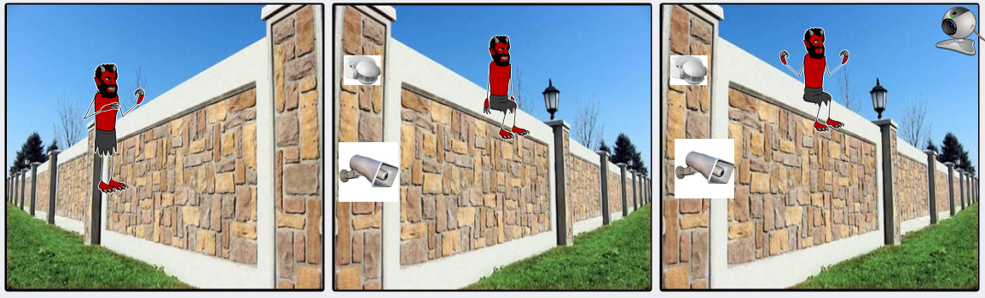
Use Case

